Slide 1

Evolution: Deeper into phylogenetics
Andrew Rominger
Omidyar Postdoctoral Fellow
Santa Fe Institute
Notes:
(This notes section won’t be visible to the presenter or viewers if you’re filming your presentation, so transfer any notes to a Word document that your media specialist can put up on a teleprompter.)
At ASU Online, we have a strong preference for video-narrated, slide-based mini and micro lectures. Use the video/audio lecture format to help students synthesize the information and to fill in content gaps between learning materials.
Reduce the on-screen text. Consider using an image instead of text, but if you must use text, use it to hammer home only the MAIN point, and let the audio narration fill in the details.
Rationale: We recommend that you really consider the value you’ll bring to the materials by adding the video or audio component to the slides. Keep in mind that humans aren’t great at multi-tasking. It's hard enough to capture learner's attention when presenting a single piece of information, so when we add another layer of information on top of it (ie, video or audio), it causes cognitive overload. We don't want you to simply read the slides, but we also don't want you talking about things that are discordant with the slides, which takes student's attention away from what they’re learning. Therefore, if you’re recording a video with slides, the only text that should be on the slides are the absolute key points that you’re discussing.
Keep videos VERY SHORT. We also strongly believe in the art of the mini or micro lecture; that is, keeping students’ attention by making your video lectures very short: 2-to-8 minutes long. Watch this video for more explanation: https://asuonline.wistia.com/medias/iyp10olbyx
It’s better to have a dozen slides with very little text than one slide with multiple concepts and dozens of words on it. It’s also better to have multiple, separate mini lectures than one long lecture (again, each video should be 2-to-8 minutes long).
What if we prefer our slides to have dense content? Consider presenting dense slides as a PPT, PDF, or Word file instead of a video. Consider recording short videos for subtopics that require further explanation.
What research supports this approach? Here are just a few research-based articles on this subject that you may find helpful:
Is lecture capture good or bad for higher education? http://www.avnetwork.com/article.aspx?articleid=116514
http://teachonline.asu.edu/2013/08/videos-in-the-classroom-is-that-really-active-learning/
http://brainrules.net/attention
http://er.educause.edu/articles/2014/4/what-makes-an-online-instructional-video-compelling
http://www.learningsolutionsmag.com/articles/1034/?utm_campaign=lsmag&utm_medium=email&utm_source=lsm-news (Nine Ways to Reduce Cognitive Load)

Slide 2
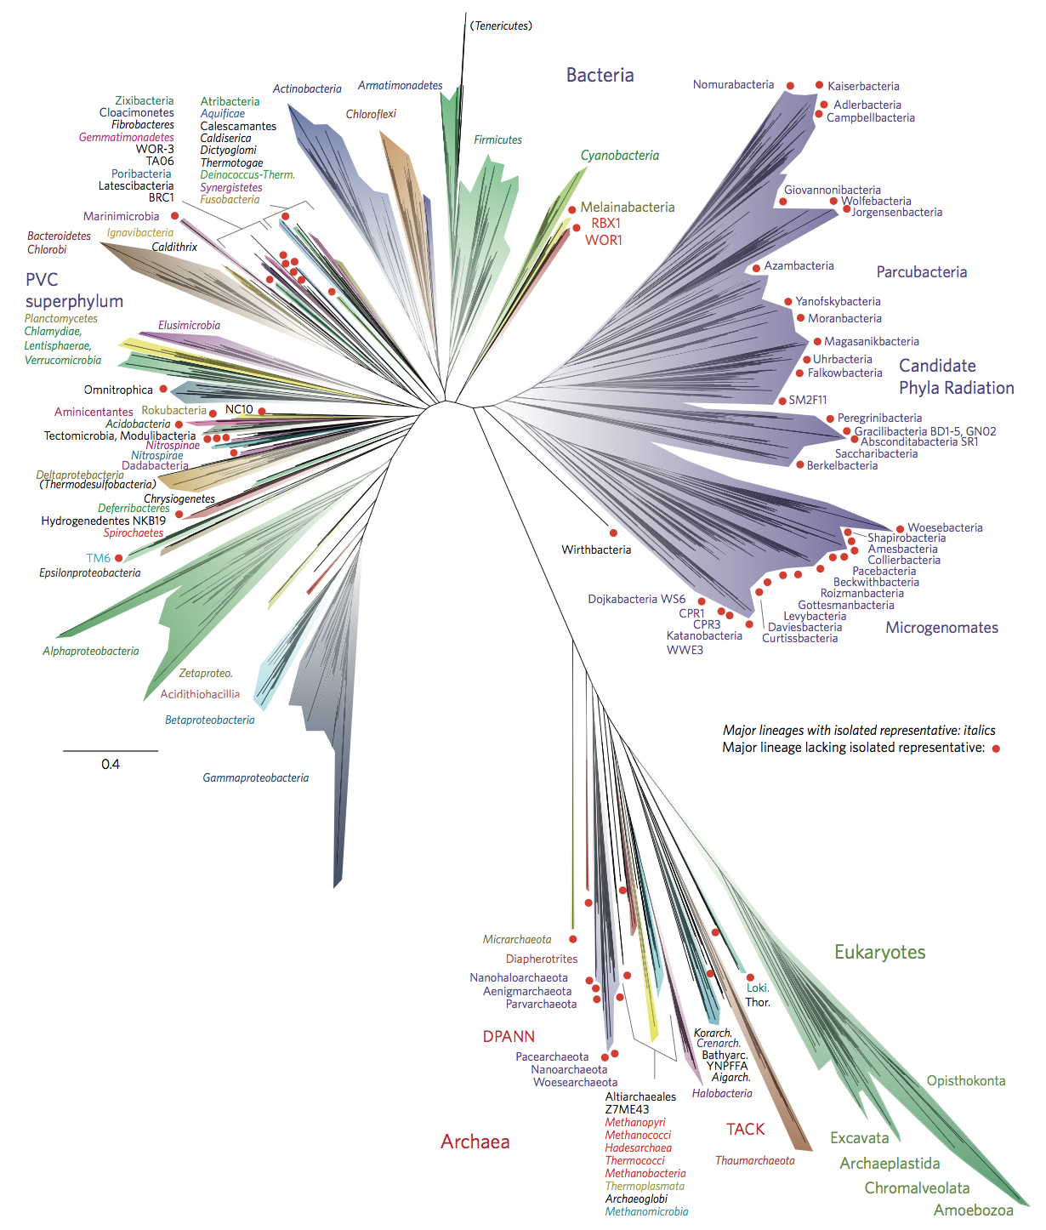
How to infer a phylogeny
How to infer ancestral traits
Why the deep past is difficult
“Banfield tree of life” Hug et al. (2016) Nature Microbiology
Notes:
Use only a couple of key words per bullet, and only a couple of bullets per slide to emphasize audio delivery. You should speak all of the details, and only show KEY words on the slides.
It’s better to have multiple slides and multiple videos to deliver dense content, as adult attention spans are very short (~2 minutes).
Do your best to keep titles and body text consistent across ALL slides. This includes font, size, and placement.
NOTE: For all slide formats, keep gray box in corner blank for superimposing video

Slide 3
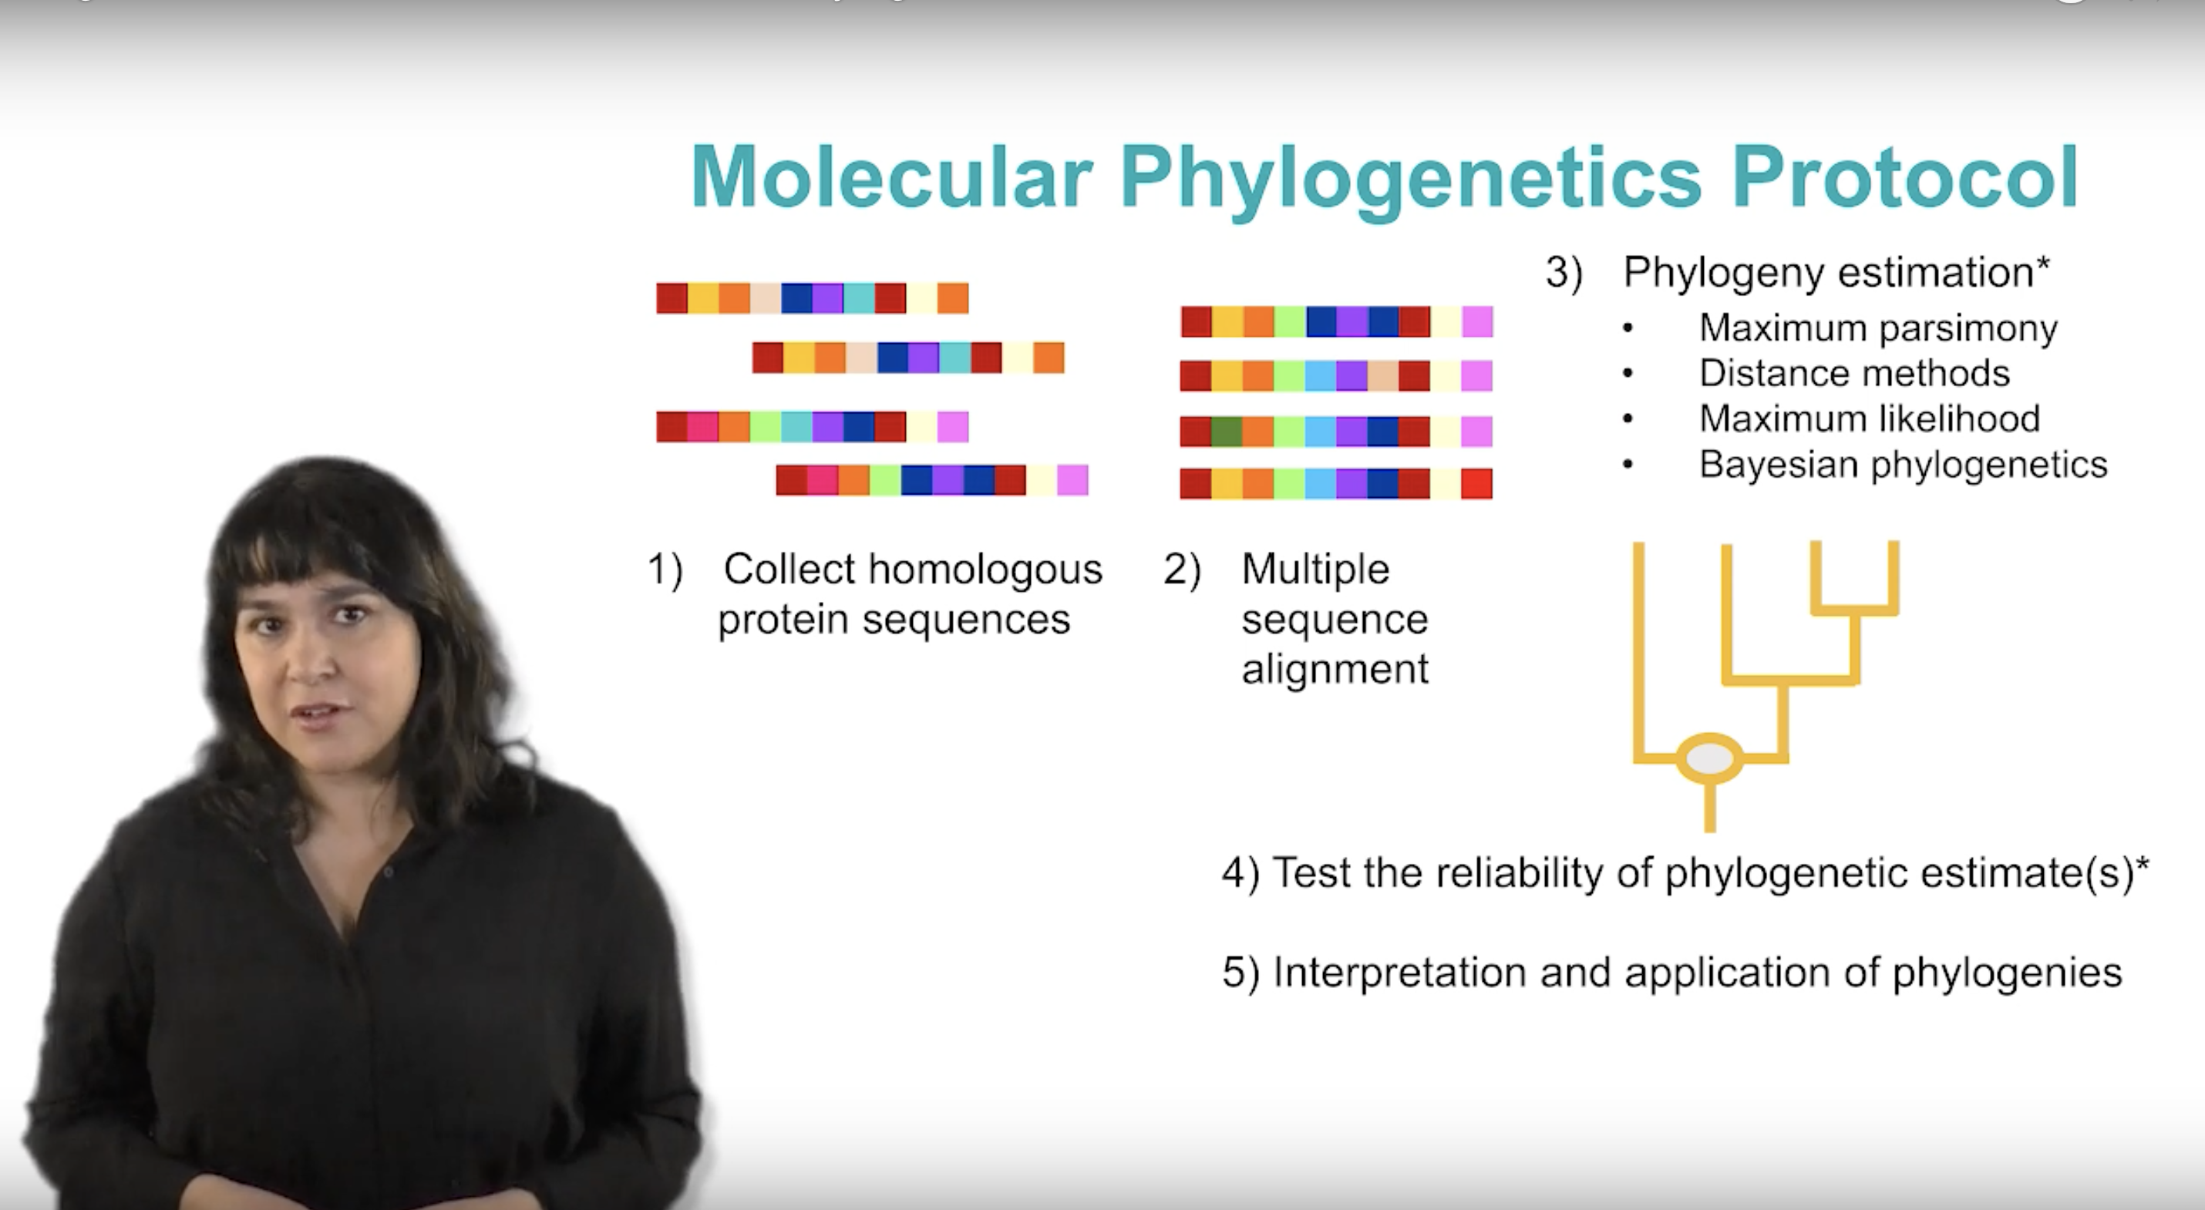
Inferring a phylogeny

Slide 4
Inferring a phylogeny

Slide 5
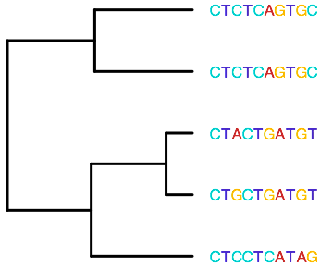
Inferring a phylogeny
Goal: find the process leading to the data

Slide 6
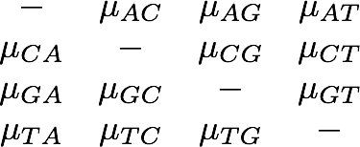
Inferring a phylogeny
Goal: find the process leading to the data
A
C
G
T
A
C
G
T

Slide 7
Inferring a phylogeny
Goal: find the process leading to the data
A
C
G
T
A
Sequence data
C
Transition rates
Topology
G
T

Slide 8
Inferring a phylogeny
Goal: find the process leading to the data
Likelihood:
Sequence data
P( | , )
Transition rates
Topology

Slide 9
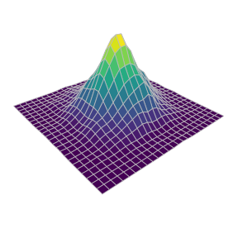
Inferring a phylogeny
Goal: find the process leading to the data
Likelihood:
Sequence data
P( | , )
Transition rates
Topology
Likelihood
Different topologies
Different transition rates

Slide 10
Inferring a phylogeny
Goal: find the process leading to the data
Likelihood:
Sequence data
P( | , )
Transition rates
Topology
Likelihood
Different topologies
Different transition rates

Slide 11
Inferring a phylogeny
Goal: find the process leading to the data
Bayesian inference: traversing the complex topology and rate matrix space lends itself to Bayesian algorithms
Likelihood
Different topologies
Different transition rates

Slide 12
Inferring a phylogeny
Goal: find the process leading to the data
Information on parsimony and distance-based methods are left for the Further Reading section

Slide 13
Inferring a phylogeny
Caveats: inferring the past is hard

Slide 14
Inferring a phylogeny
Caveats: inferring the past is hard
1
2
Likelihood
3
4
5
Different topologies
Different transition rates

Slide 15
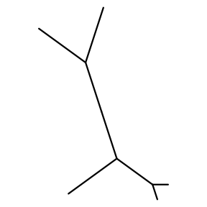
Inferring a phylogeny
Caveats: inferring the past is hard
“Unrooted” phylogeny arrises because mutation process is reversible in our models
1
2
Likelihood
3
4
1
2
5
Different topologies
Different transition rates
3
5
4

Slide 16
Inferring a phylogeny
Caveats: inferring the past is hard
“Banfield tree of life” Hug et al. (2016) Nature Microbiology

Slide 17
Inferring a phylogeny
Caveats: inferring the past is hard
Rooting the tree with an outgroup

Slide 18
Inferring a phylogeny
Caveats: inferring the past is hard
Rooting the tree with an outgroup
Common ancestor
Outgroup

Slide 19
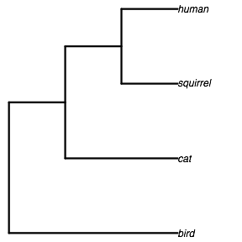
Inferring a phylogeny
Caveats: inferring the past is hard
Rooting the tree with an outgroup
Common ancestor
Outgroup

Slide 20
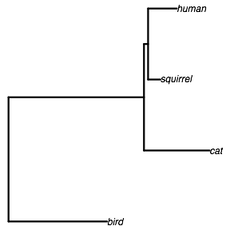
Inferring a phylogeny
Caveats: inferring the past is hard
Rooting the tree with an outgroup
Rate heterogeneity means mutations are not “clock-like”

Slide 21
Inferring a phylogeny
Caveats: inferring the past is hard
Rooting the tree with an outgroup
“Banfield tree of life” Hug et al. (2016) Nature Microbiology

Slide 22
Inferring a phylogeny
Caveats: inferring the past is hard
Rooting the tree with an outgroup
Rate heterogeneity means mutations are not “clock-like”

Slide 23
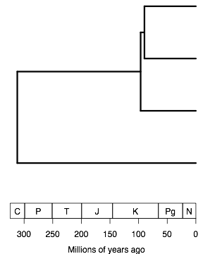
Inferring a phylogeny
Caveats: inferring the past is hard
Rooting the tree with an outgroup
Time calibration
We must calibrate phylogenies with independent data, e.g. the fossil record, known mutation rates for specific groups

Slide 24
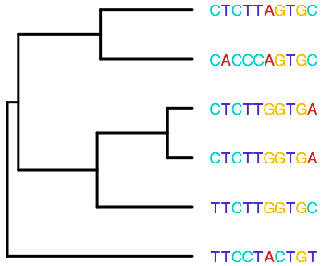
Inferring a phylogeny
Caveats: inferring the past is hard
Rooting the tree with an outgroup
Time calibration
Long branches “attract” each other
A
C
G
T
A
C
G
T

Slide 25
Inferring a phylogeny
Caveats: inferring the past is hard
Rooting the tree with an outgroup
Time calibration
Long branches “attract” each other
A
C
G
T
A
C
G
T

Slide 26
Inferring a phylogeny
Caveats: inferring the past is hard
Rooting the tree with an outgroup
Time calibration
Long branches “attract” each other
A
C
G
T
A
C
G
T

Slide 27
Inferring a phylogeny
Caveats: inferring the past is hard
Rooting the tree with an outgroup
Time calibration
Long branch attraction

Slide 28
Inferring a phylogeny
Caveats: inferring the past is hard (especially in deep time)
Rooting the tree with an outgroup
Time calibration
Long branch attraction
What genetic information goes back to LUCA?
Bacteria
Billions of years
Human

Slide 29
Inferring a phylogeny
Caveats: inferring the past is hard (especially in deep time)
Rooting the tree with an outgroup
Time calibration
Long branch attraction
What genetic information goes back to LUCA?
Ribosomal RNA and protein genes
David Goodsell

Slide 30
References and Suggested Reading
Huelsenbeck, J. P., & Ronquist, F. (2001). MRBAYES: Bayesian inference of phylogenetic trees. Bioinformatics, 17, 754-755.
Huelsenbeck, J. P., & Crandall, K. A. (1997). Phylogeny estimation and hypothesis testing using maximum likelihood. Annual Review of Ecology and Systematics, 28, 437-466.
Hug, L. A., Baker, B. J., Anantharaman, K., ... & Banfield, J. F. (2016). A new view of the tree of life. Nature Microbiology, 1, 16048.
Philippe, H., Zhou, Y., Brinkmann, H., Rodrigue, N., & Delsuc, F. (2005). Heterotachy and long-branch attraction in phylogenetics. BMC Evolutionary Biology, 5, 50.
Quast, C., Pruesse, E., Yilmaz, P., ... & Glöckner, F. O. (2012). The SILVA ribosomal RNA gene database project: improved data processing and web-based tools. Nucleic Acids Research, 41, D590-D596.
Sanderson, M. J. (2003). r8s: inferring absolute rates of molecular evolution and divergence times in the absence of a molecular clock. Bioinformatics, 19, 301-302.
Smit, S., Widmann, J., & Knight, R. (2007). Evolutionary rates vary among rRNA structural elements. Nucleic Acids Research, 35, 3339-3354.
Notes:
Comparison slide

